Slide 1
Spectrometers for Multi-TeV
Forward Particles at the LHC
Michael Albrow, Fermilab
Introduction: Terra Incognita! Strong Interactions and cosmic ray showers
Some physics topics: single- and two- particle inclusive and full event structures
TeV particles through 30 Tm spectrometer magnets, special vacuum chamber
Tracking, Calorimetry and Muons
Hadron identification : π, K, p with transition radiation detectors
Extending x_{F} coverage with bent crystal channeling
What’s next? A new collaboration or extensions of ALICE and LHCb?
Had a 2-day meeting at CERN Oct 1st & 2nd to discuss this (~ 30 participants)
Thanks to participants and their slides

Slide 2
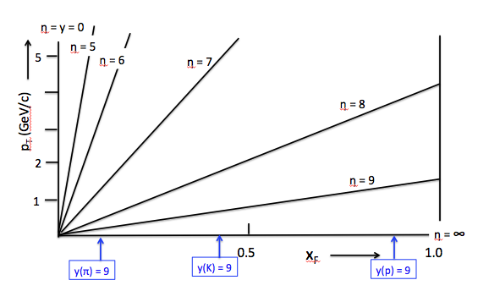
ATLAS, CMS, etc
Terra Incognita
ROMAN POTs
Last explored at ISR at √s = 63 GeV, 200 x lower
All fixed target experiments < ISR (≅ 2000 GeV FT)
y(π) = 10
ZDC, LHCf measure neutrals (n, π⁰ →γγ) at very small angles.
y(π) = 11

Slide 3
Idea, using 10 – 15 m of space in front of TAN:
Use MBX dipoles (Integral B.dL ~ 30 Tm) as spectrometer magnets.
Use straight section from ~ 85m to 140m (TAN absorber) space.
Special vacuum chamber design for particles to emerge through minimal material
Precision tracking (silicon strips or pixels) over a 2 m (θx, θy to a few μrad)
Transition Radiation Detectors for γ = E/m in 10³ – 3. 10⁴ region
Hadron Calorimeter for energy measurement
Muon tracking behind calorimeter
Bent crystal to channel and so accept highest momenta (>~ 4.5 TeV, ~4 mrad bend)

Slide 4
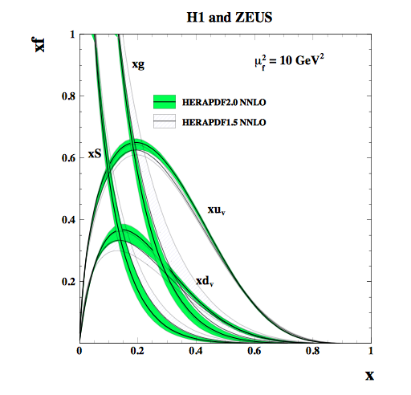
x_{Bjorken} = x_{Bj} = p(parton)/p(proton)
Major industry at HERA, and these PDFs
Needed for hard (partonic) interactions at LHC
x_{Feynman} = x_{F} = p(hadron)/p(proton)
x_{F} – x_{Bj} relationship, but less direct than
in deep inelastic scattering.
E.g. p → π⁺ is from leading u adding a dbar
p → π⁻ is from leading d adding a ubar
Ratio at high x reflects u:d in p
u
u
u
d,c,bbar
d
u
d, c, b
d
Leading π⁺, D⁰, B⁺ (?)
t-channel baryon
exchange
(Reggeized)
Not measured for x_{F} at √s > 63 GeV

Slide 5
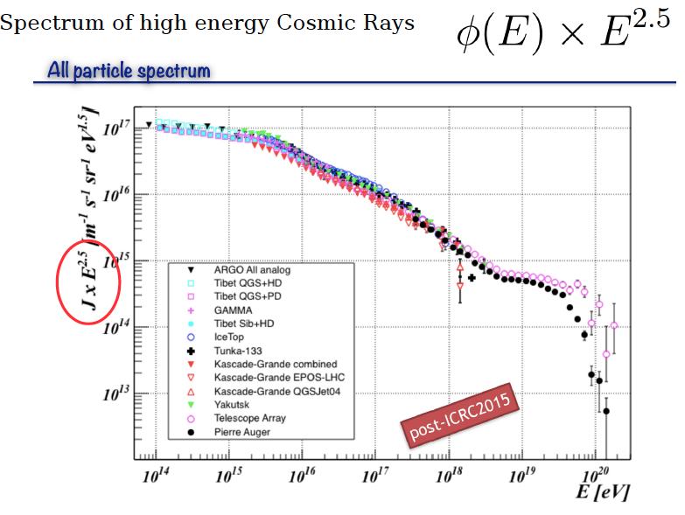
COSMIC RAY SHOWERS: ASTROPHYSICS CONNECTION
Lipari, SAS@LHC
Knee
Intermediate region
ISR-63 GeV
Ankle
GZK Cut-off
LHC-13 TeV
AUGER
x 200 in √s = x 40,000 in FTE

Slide 6
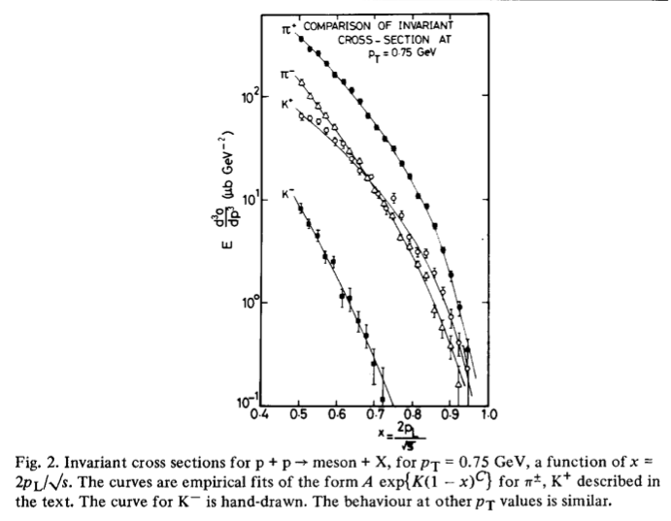
√s = 45 GeV,
CHLM (MGA inter alia) SAS @ ISR
Nucl Phys B 140 (1978) 189
37 years ago !

Slide 7
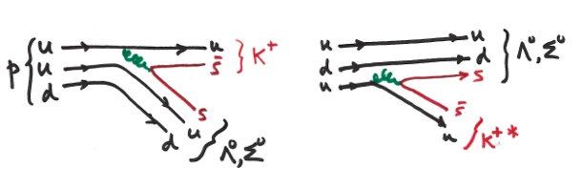
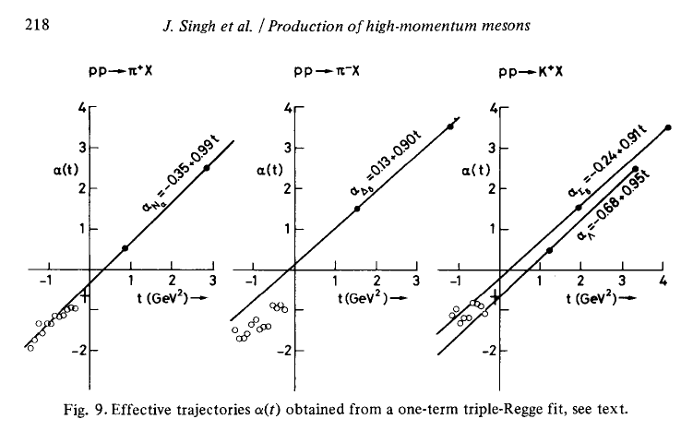
Challenge to theorists
Strong Interactions at low-Q²
Hadron level ~ Regge theory
Parton level ~ QCD (non-perturbative)
Leading (high x_{Bj}) u-quark or [ud] di-quark picks up an sbar or s in “string-breaking”
or from s-sbar sea, to make a leading K⁺ or Λ⁰, Σ⁰
γcτ(Λ) at 4.4 TeV is 316 m, → pπ- (acceptance?). Σ⁰ --> Λ⁰ + γ (100%, prompt)
Virtual (negative mass², t-channel) exchanged
baryon or meson described in
Regge phenomenology :
Analyticity, unitarity and crossing symmetry
+ continuous complex angular momentum.
Derive it from QCD !! ?
Quark line description of leading K⁺ or Λ⁰, Σ⁰

Slide 8
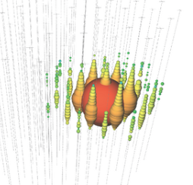
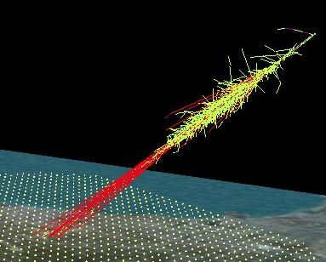
COSMIC RAY SHOWERs
ICECUBE Event 20 : 1140 TeV ν
Simulated UHE Cosmic ray shower over
Auger observatory in Argentina
PMTs in Antarctic ice, 1 km³
Simulating showers relies
on particle production
cross sections that are
not well known
MUONS!
Water Cherenkov tanks ~ 1 km spacing
One day : p-N and N-N collisions ?

Slide 9
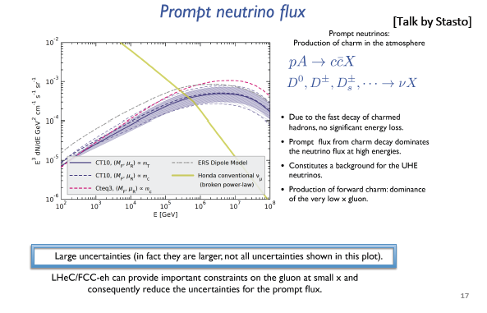
10¹⁷ eV
Forward charm can be measured more directly in SAS@LHC

Slide 10
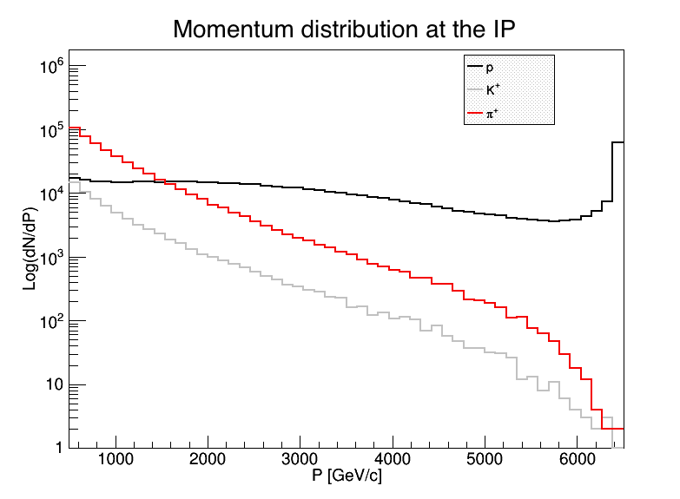
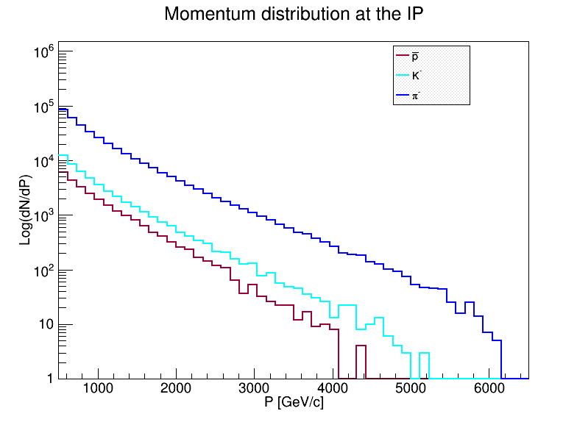
DPMJET prediction
Could be quite differerent!
Spectra generated by /DPMJET-MARS
With 10⁶ pp events, √s = 13 TeV
(N.Mokhov and O.Fornieri)
In 1 second, with 2808 bunches,
Have 30 x 10⁶ bunch crossings and
30 x 10⁶ x μ(= interactions/X) events.
Notes:
At 0.5 TeV (~ central)
π⁺ = π⁻ & K⁺ ≅ K⁻ & K/π ~ 10%
p’s > π⁺ above 1.5 TeV and flattish;
High xF peak from diffraction
K⁻(s-ubar) steeper than K⁺ (sbar-u)
π⁻ (d-ubar) steepler than π⁺ (u-dbar)
Antiprotons < K⁻ but only by a factor ~ 0.5
Number per 125 GeV/c bin
~ 100 x Acc/bin/sec if μ ~ 3
Number per 125 GeV/c bin

Slide 11
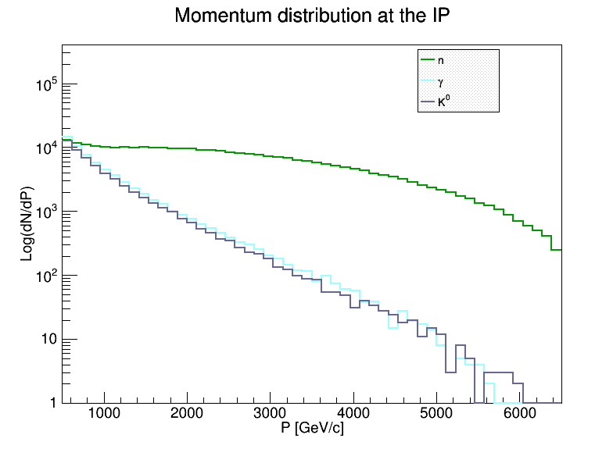
Neutral particles from collisions at 13 TeV : DPMJET predictions
Measured in LHCf, ZDC. Very different from charged particle spectra
SAS@LHC would have a hadronic calorimeter (EM showers in TRD)
Can be much better than LHCf ZDC with e.g. higher granularity, better containment

Slide 12
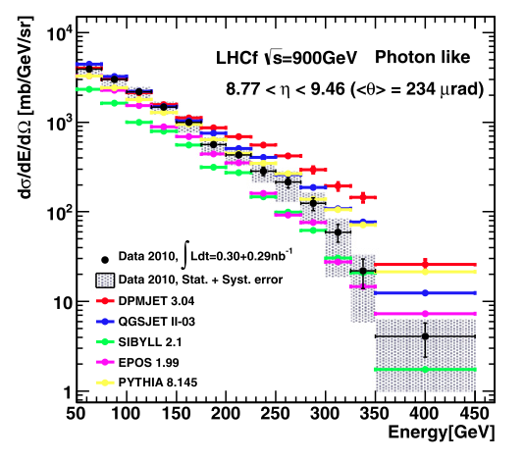
LHCf is a small 0º calorimeter measuring photon-like and n-like showers
Only 1.6 λ_{I} and 4 cm in size, σ(E)/E ~ 40% for neutrons.
To illustrate the large spread in predictions even at
much lower √s (900).
ZDC in CMS
7 λ_{I} and 8cm x 10 cm
Expect σ(E)/E ~ 15% at 3 TeV
A good 3D-imaging calorimeter
for SAS : σ(E)/E ~ 5%

Slide 13
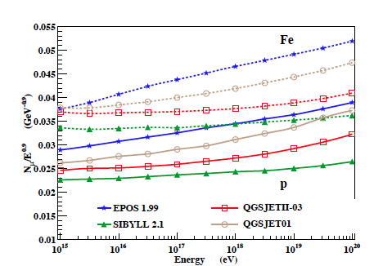
Example of spread in Cosmic ray shower simulations
# muons on ground / E^{0.9} (to flatten curves) vs E.
p- Air (solid) and Fe- air (dashed)
From FPWG_YELLOW_REPORT : CERN/LHCC 2013-021
These are on air not pp.
LHC has also run p-Pb and Pb-p
and SAS could take data there.
What about p-N and N-N?
Such special running may (should)
become more acceptable in future.
Heavy ion groups (ALICE et al)
would support this.
Big spread even assuming no
surprises, e.g. high forward
heavy flavor production
Equivalent FT energy of √s = 13 TeV
E≅ = s/2m_{p}

Slide 14
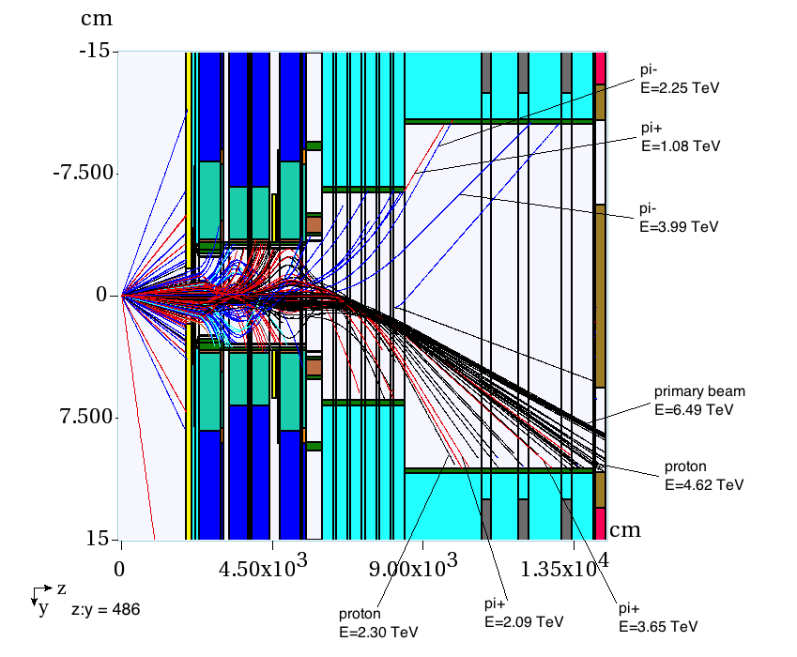
200 inelastic collisions at Pt 5 ( 13 TeV, β* = 0.55 m): MARS
Nikolai Mokhov
Ottavio Fornieri
If μ = 1 this is 200 bunch crossings = 6 μs
TOP VIEW
Scale factor x:z = 486:1
Negatives
From interaction
Λ → pπ-
Positives
Hitting pipe: 2 π- and 4π+ and about 8 protons / 200 collisions. Mostly near horizontal plane

Slide 15
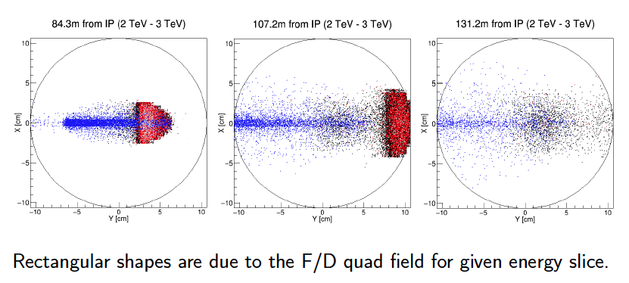
MARS simulation (Nikolai Mokhov and Ottavio Fornieri (summer intern))
For Pt.5 (CMS) with β* = 0.55m : need to do for β* = 5m at at LHCb, ALICE
Looking along 20 cm diam beam pipe: only particles inside pipe shown, at 3 distances
- ves
2 TeV – 3 TeV particles
+ ves
These all exit pipe between 107 and 131 m
>> Only need to cover ~ 10 cm in y on L and R sides, not all ϕ

Slide 16
Particle transport calculations (Pt.5, β* = 0.55m) using MAD files
Jerry Lamsa
Positive particles contained
in 40 cm diam pipe.
Only +/- 5 cm in y needed
for p_{T} <= 0.4 GeV/c
Negatives on left side (not shown)
Less y coverage adequate
(focusing)
x, y, θ_{x} and θ_{y} needed for p_{T}, p_{z}, ϕ
Outgoing p beam
Calculations shown are for
Pt.5 and specific optics.
At Pts 2 and 8, larger β* and
different, need specific calculations.
Ellipses for p_{T} = 0.4 GeV/c, all ϕ.
For single particle inclusive spectra do not need full ϕ – coverage, but valuable for correlations

Slide 17
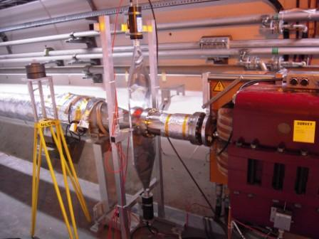
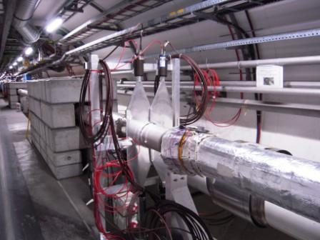
On both sides of Point 5 (CMS) we installed Forward Shower Counters FSC
As “rapidity gap” detectors in low pile-up diffractive collisions.
Simple (scintillators + PMTs) and information limited to showering particles.
MBX beam separation dipoles on Right
Start of 50 m 20cm diam pipe on left.
Half way along, FSC-2.
Concrete shielding walls can be
adapted if necessary
LHCb system “HERSCHEL”
(Paula Collins inter alia )
Points 2 (ALICE) AND/OR 8 (LHCb) more
appropriate (Low PU, physics focus, Heavy Ions)

Slide 18
Beam pipe design for small angle spectrometer (schematic)
50 cm (?) diameter pipe from 85m to 130m (from collision)
(Jerry Lamsa)
40 mm thin window (Be? Al?)
Minimize scattering/imteractions
Benoit Salvant talk
TOP VIEW
10-15m for detectors
50 cm
VACUUM
Inner thin foil or wire grid
~ 40 m large pipe
50 cm diam pipe
-ves
+ves
iNCOMING
BEAM
OUTGOING
BEAM

Slide 19

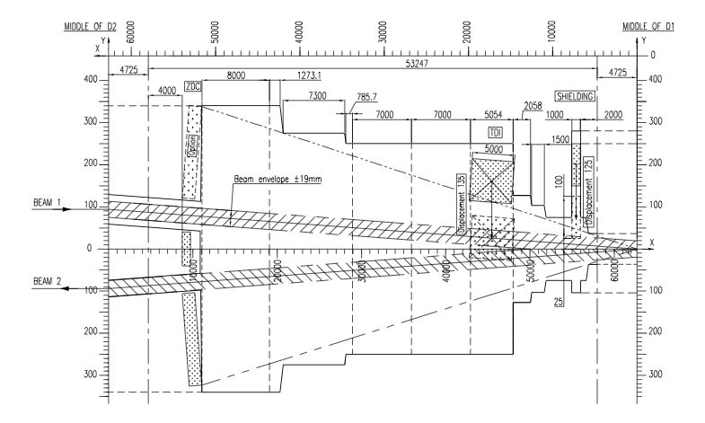
ALICE : Already have a large conical beam pipe for ZDC
> Centrality etc measurements in Heavy Ion (Pb+Pb) collisions
TOP VIEW
ZDC
70 cm
ZDC
Make space in front of calorimeter (with “thin” window) for
tracking, TRDs, and behind calorimeter for muon measurement.
Muons
Calorimeter
-----------TRD-----------
Tracking
particles
1m 2.5m 6 - 8m 2m total = 12- 15m

Slide 20
SAS as a Multi-particle Spectrometer
Acceptance for 2 or more particles from same event.
Positive and negative particles on opposite sides of pipe, near horizontal plane.
Acceptances need to be calculated … may be small or zero for some particles
But potentially:
J/ψ, ψ(2S) → μ+μ-, χ_{c} → J/ψ + γ, Drell-Yan μ+μ- , γγ → μ+μ-
K⁰_{s} → π⁺π⁻, Λ → p π
D⁰ → K⁺π⁻ … χ_{c} → π⁺π, K⁺K⁻, etc.
Very forward charm and beauty also measured with single leading e and μ
Leptons can be identified (how well? Background from fakes?)
Leptons from π, K decay will be known, and their decay lengths are very long!
γcτ (π) = 340 km at 2.5 TeV !
Just a thought:
Bose Einstein Correlations
Two same-sign pions (or kaons) close in phase space
Correlation (excess) width → size of emission region
At θ ~ 0 transverse size (overlap)
Interest in heavy-ion collisions … maybe pp too
Correlate with central event.
+
Small Δp
~ 1/D
D
+

Slide 21
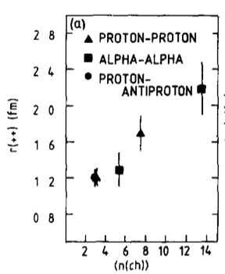
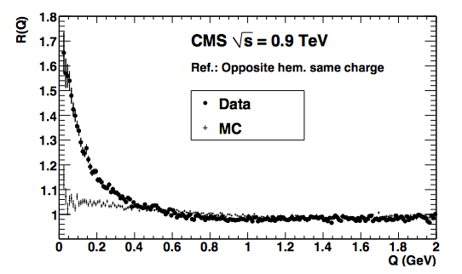
Heavy – ion collisions (ALICE Specialty)
So far : p + Pb and Pb + Pb, with p + p in ALICE as “control” to study changes.
One day (feasible) : p + N and N + N as in atmosphere
Must be many interesting studies to do with SAS.
Here just two off “top-of-the-head”:
Bose-Einstein correlations
between π+π+ & π-π- close in
momentum measure size of
pion emission region.
Directional: correlate with φ(jets)
Head-on view
Nuclear fragments:
d, t, He³, He⁴, Li…
Jets this way
quenched
Jets this way emerge
not quenched
PL 129B (1983) 269 (R807, AFS)
down beam pipe
π
π
PRL 105 (2010) 029

Slide 22
ALICE has pp collisions “for free” for most of the LHC running
Cannot compete with ATLAS and CMS for high mass/high p_{T} pp physics
Luminosity/pile-up much lower (good for SAS) and appropriate detectors.
Focus (pp) is on high multiplicity events, particle correlations, heavy flavor at low p_{T} …
Can have unique strong interaction program with SAS (maybe competing with LHCb)
LHCb focus is on charm and beauty, forward (but not this forward)
Also low PU (good) with β* = 5m (not 0.55m)
SAS extends spectrometer to y ~ 8, 9
Acceptances not yet calculated but will be (Gianluca Cavoto inter alia).
SAS
SAS

Slide 23
Tracking
Precision tracking immediately behind (thin!) vacuum pipe window (Be?)
No field so straight tracks.
x, y, dx/dz, dy/dz at z σ(x,y) = 10 μm over 2m -> 5 μrad
Cf bend of 6.5 TeV proton ~ 1500 μrad
Projection of track back → momentum dp/p < ~ 0.5% if from primary vertex.
Can be matched with energy from calorimeter if hadron
Background from showers in upstream pipe etc. can be reduced or even eliminated.
Tracking measures |Q| also.
Θ = 0.3 B.L(Tm) / p (TeV/c)
[x₀,y₀,z₀, p_{x}, p_{y}, p_{z}] [x, y, θ_{x}, θ_{y}, E = p]
at collision at z (Q known)

Slide 24
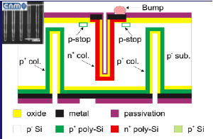
Tracking is a solved problem, many solutions, much experience
Probably silicon strips (low occupancy) in 3 orientations, or pixels, standard technology.
3D silicon rad hard, “edgeless” probably good solution. Not yet “off the shelf” but
being developed, by end 2016 could be standard. Non-3D is standard now.
About 12 planes e.g. 4 triplets ? Two tracking stations on + and – sides, Area ~ 10cm x 10 cm.
Only ~ 0.2 m², latch on to an order from the big experiments like CMS?
This could provide a level 1 trigger requiring a track through, and could “look up”
p_{x}, p_{y}, p_{z} or p_{T}, p_{z} if desired in simple fast trigger processor.
Particles
3D silicon:
Columns front-back
Drift is sideways.
Planned for CT-PPS etc.

Slide 25
Calorimeters
Wanted for energy measurement
Complements tracks Δp/p ~ 1% if 1^{ry} , and ΔE/E ~ 5% probably achievable.
Follow track upstream with p = E to z = 0.
Primaries have x = y = 0 at z = 0, background not.
EM : probably not useful behind TRD (a few X₀ already … TRD as ECAL?)
HADronic sections … can be very deep (even 3m); λ_{I}(W) = 10 cm
– good muon filter
Can profit from major developments in high granularity calorimeters
But our modules much smaller (protoype test module size)

Slide 26
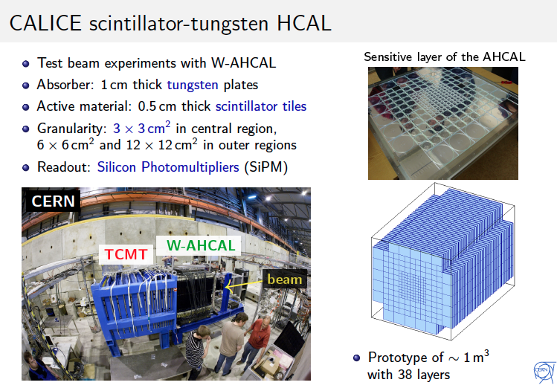
Calorimeter Example 1
Or just keep this
Discard this part
Eva Sicking’s talk

Slide 27
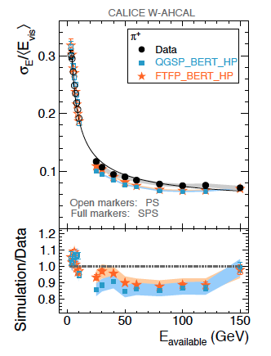
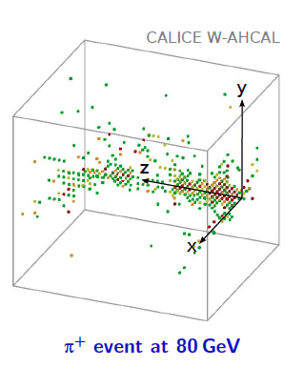
Eva Sicking’s talk
Test beam data and predictions
Highly granular 3D information
Details of 3D “shape” help correct
for side leakage (only on pipe side)
(side-catcher?)

Slide 28
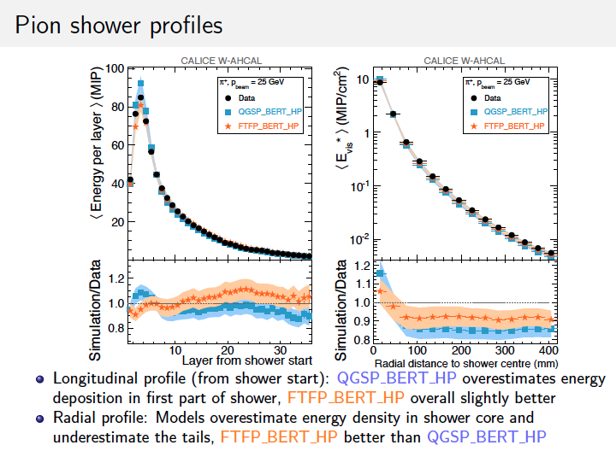
Eva Sicking’s talk

Slide 29
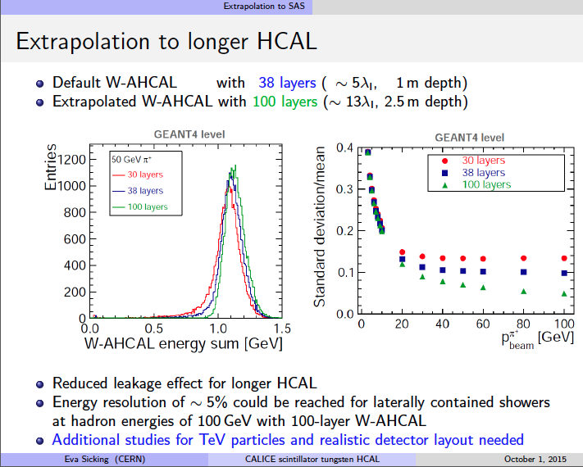
Eva Sicking’s talk
Tungsten Scintillator Calorimeter 2.5 – 3 m deep should be fine, and σ(E)/E ~ 5%

Slide 30

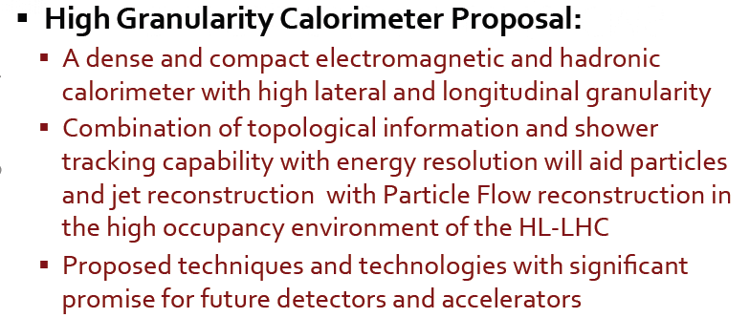
Slawek Tkaczyk’s talk
Much harsher environment , very high pile-up, energy density/25 ns, mechanical constraints,
Hard to access operation for ~ a decade. → A very big effort developing. $$$
SAS ~ test beam prototype. “Maybe we could get one?”

Slide 31
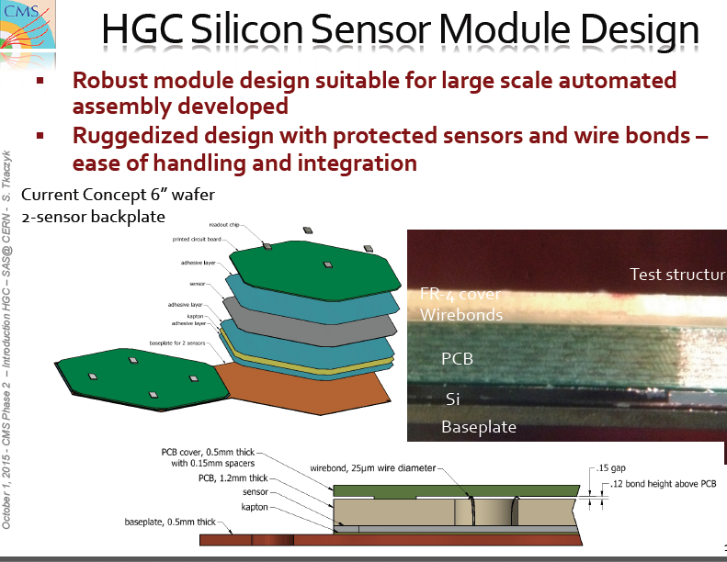
Slawek Tkaczyk’s talk

Slide 32
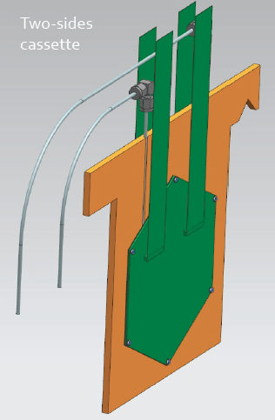
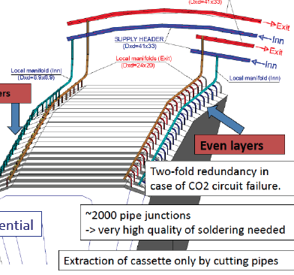
Slawek Tkaczyk’s talk
Test beam modules : Hanging file design
Very versatile if flexibility desired (Can change configuration, insert special layers, etc.
Could be appropriate for SAS. Two support rails for each of the two modules.
A major complication for CMS is cooling, as
Calo in confined space.
SAS cooling simpler: blow cold air.

Slide 33
A good hadron calorimeter, compact (tungsten plates) to minimise lateral leakage can be
made in ~ 2.5 m of longitudinal space.
Sampling can be with scintillator tiles or bars, silicon pads, or “other” …
Readout of scintillator can be with PMTs or (now cheap and fast) SiPMs
Could include special imaging layers (micromegas?) if useful.
As occupancy low, and we know from tracking where charge particles enter,
bars (e.g. 1cm x 20 cm x 5 mm) in an x-y or u-v-x layer arrangement OK.
>> Fewer channels for higher spatial resolution in projections.
If SAS taken up by ALICE or LHCb they already have calorimeters, may “simply add”.
CALORIMETRY for SAS can be done

Slide 34
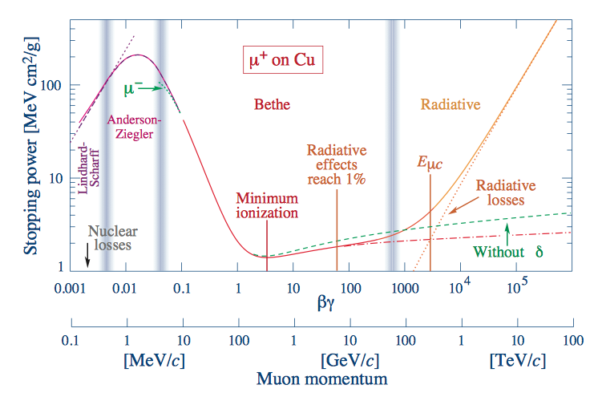
Muon Measurement behind calorimeter
Muons : from primary collision:
Drell-Yan pairs, photo-produced J/ψ, ψ(2S), Υ_{1,2,3} and γγ → μ⁺μ⁻ (especially in AA)
Some acceptance for measuring both! What is it?
Almost prompt, from c, b decays. Note BR ( D⁰ → μ + X) = 6.7%
Background from π, K etc decays. γcτ(π) at 2.8 TeV = 150 km, . γcτ(K⁺) = 70 km
Background from upstream interactions in pipes etc.
Momentum from upstream tracking, penetration and energy loss (fn(E)) through calorimeter
TRD signals consistent with m = p/γ = m(μ) (= m(π) , no separation.
HERE

Slide 35
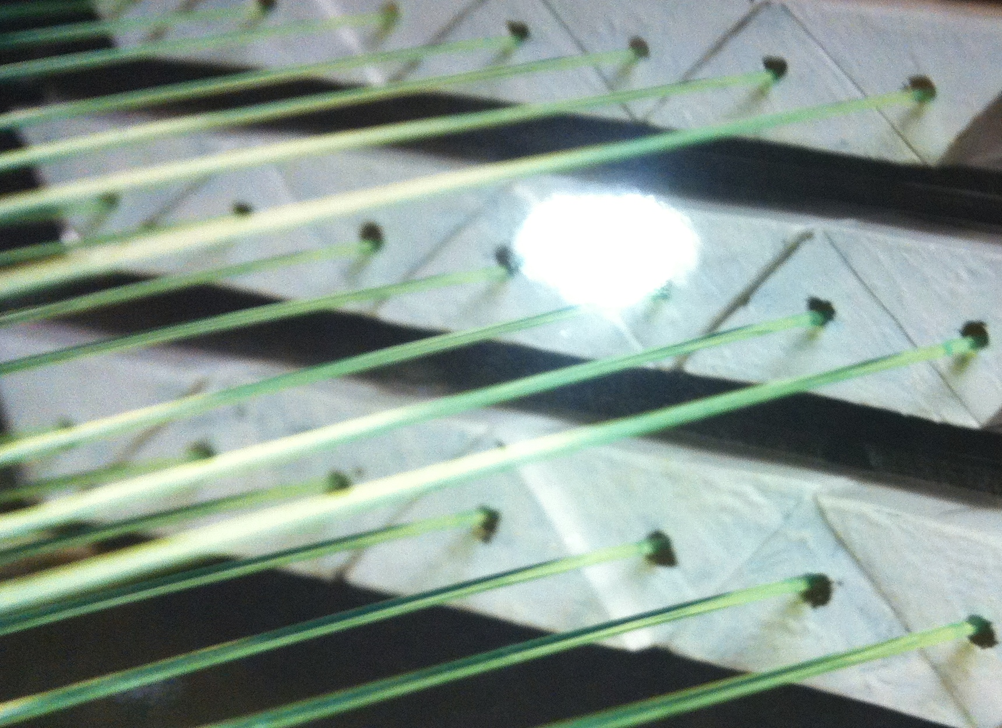
Muon Detectors
… also punch-through monitoring
+ Background from π or K decay. Lifetimes very long: γcτ(π/K) at 2.8 TeV = 150/70 km
But we measure π and K spectra and know this well.
Background from upstream interactions in pipe, materials; tracking (& E) should eliminate this.
Area should match calorimeters, so ~ 20 cm x 30 cm on each side.
Simply to require a crude “track” matching the upstream detectors (tracking + TRD)
Probably σ(x, y) ~ 5 mm is fine, and about 1 – 2m long*
There are many established technologies. This one (Dzero):
has ~ 2 cm “toblerone” bars with WLS fibers, can have
SiPM at each end. Pulse height sharing → x coord.
3 views u,v,x at front and back of 1 – 2m space.
If done with ALICE / LHCb they have technologies:
RPCs with Cathode pads, MWPCs and triple-GEMs

Slide 36
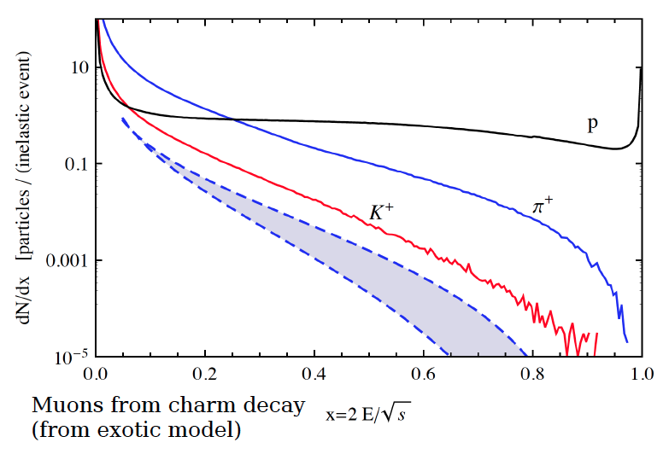
Charm and beauty hadrons only measured at LHC in central region.
Some models, e.g. Stan Brodsky “intrinsic heavy flavor” have enhanced forward Q production
-- Massive Quarks in sea carry high momentum for same rapidity (At p_{T} = 0 x_{F} = m.e^{y} / √s)
c, b → μ gives excess prompt muons at large xF.
In Δx = 0.1 at x = 0.4 about 10⁻³ per inelastic event. At PU = 1 have 30 million X/sec : ~ 10⁴ μ/s !
μ?

Slide 37
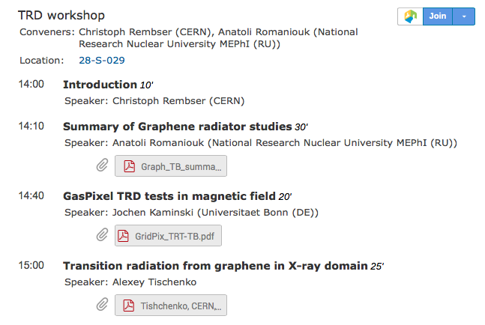
Transition Radiation Detectors - TRD
Probably only technique for distinguishing π / K / p at multi-TeV energies
Interesting challenge far beyond usual e/π separation
Half day parallel session on TRD developments and prospects
2-Day Meeting on SAS@LHC, CERN, Oct 1 + 2

Slide 38
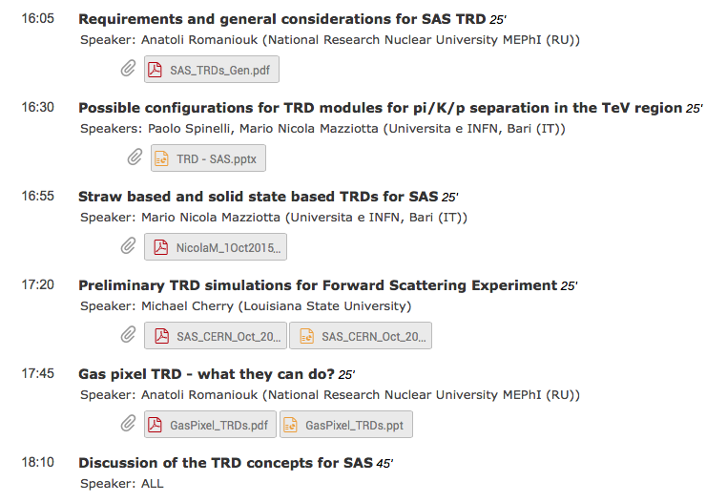

Slide 39
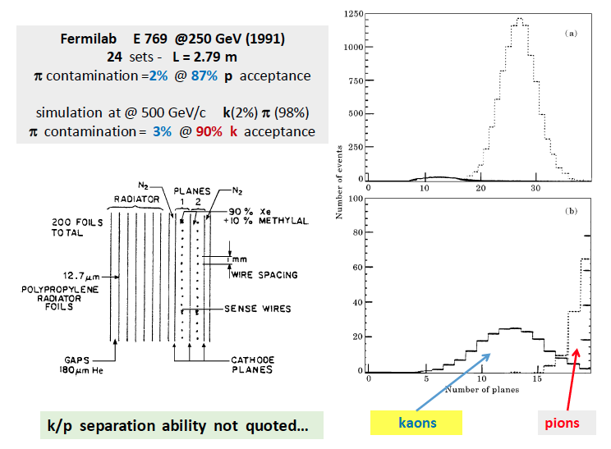
E769 (Jeff Appel inter alia) used TRDs to distinguish beam particles and measure fwd charm

Slide 40
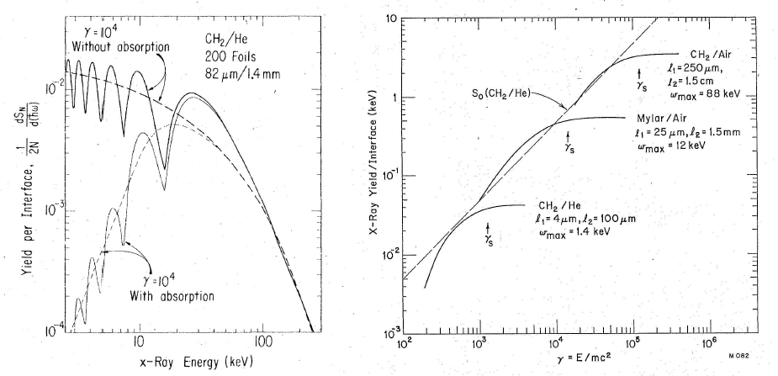
Technical challenge: Identification of multi-TeV π/K/p
Mike Cherry
Cherenkov counter cannot as “β = 0.99..999” for all.
Only game in town: Transition Radiation Detectors TRD
Interface between two materials different ε → X-ray emission ~ 1/137 but prop-to γ = E/m
Know E = p from tracking and calorimeter, hence m.
Fastest hadrons in SAS ~ 5 TeV π; γ = 5000/0.14 ~ 3.6 10⁴
Slowest in SAS ~ 1 TeV p; γ = 1000/0.94 ~ 1.1 10³
Can “tune” design
for γ – range : higher γ longer
In PDG
Increasing foil thickness
Increasing gaps
1 TeV p
5 TeV π
RANGE

Slide 41
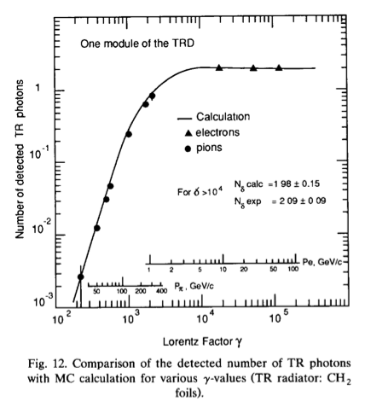
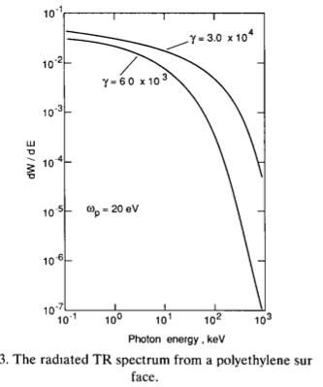
Identification of π/K/p : Main technology challenge! (Crystals are too)
Transition radiation at interfaces between
Materials of different dielectric constant measure γ = E/m (E from calorimeter)
10 % measurement of γ with 5% measurement of E → good separation
Dolgoshein
4.2 TeV π
6 TeV p
Mike Cherry

Slide 42
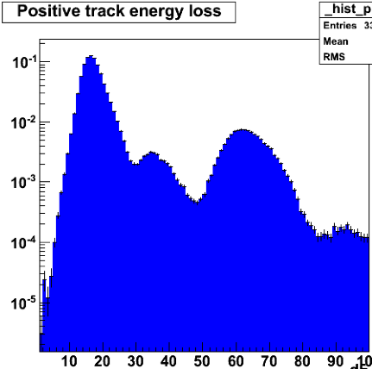
Note: To measure single hadron inclusive spectra do not need 5%/10% separation!
Example from CDF Drift chambers of dE/dx ionization measurement in one p-bin (400 MeV/c)
π
NOTHING TO DO WITH TRD!
JUST TO MAKE A POINT
p
Fit → composition for
all p-bins → spectra.
(Also pile-up irrelevant.)
Better separation needed to
do correlations e.g. M(Kπ) … D0?
and with central event, e.g. :
K
(d)
K±
TRDs in SAS, like other detectors, accessible and replaceable as improved

Slide 43
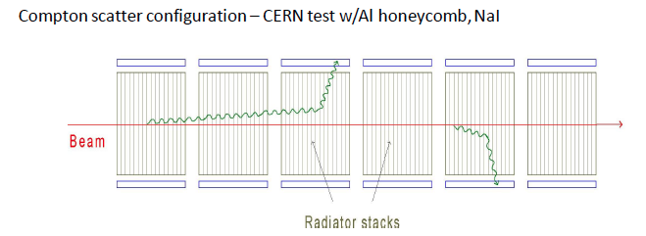
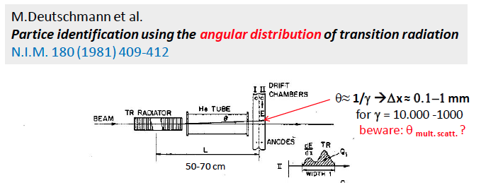
In principle can also detect Compton scattered X-rays on sides of radiator stack:
Another old idea, now perhaps feasible with new detectors (e.g. micromegas):
Mike Cherry

Slide 44
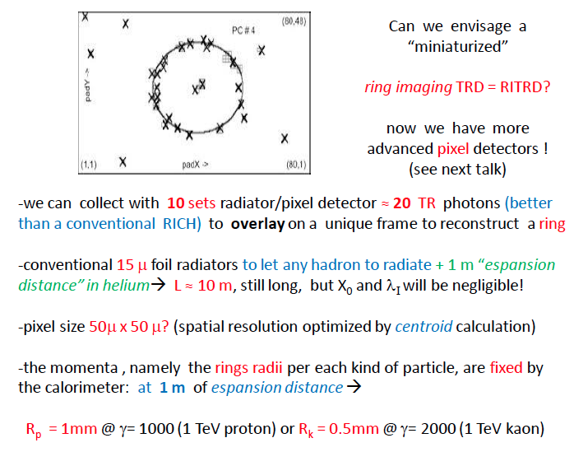
TRD also provides precision traking information!
Mike Cherry, Louisiana State Univ., summary talk

Slide 45
Acceptance for higher x_{F} ~ 0.7 – 0.9
Bent crystal channeling
Large area of research, annual international conferences etc.
Needed to cover x_{F} > ~ 0.8 – 0.9 region, otherwise down beam pipe.
Intercept particles close to beam at around 90m
with long (~ 12 cm?) crystal with 4 – 5 mrad deflection.
Inside vacuum chamber, position and angle steering.
Developments over years, for beam collimation and also extraction (AFTER)
In principle : SAS → study interactions of TeV identified mesons.
W.Scandale, G.Cavoto inter alia (UA9 collaboration … tests in SPS, LHC)
Protons probably > 99% at x_{F} = 0.9 .
Into diffractive proton region for high mass and high-t (acceptance?)
Study heavy flavors in high-mass diffraction e.g. in central detector.
(Low mass diffraction e.g. p → p π+π- may be studied inside SAS)
And rarest high-x mesons may be most interesting!
UA9 Experiments

Slide 46
Bent crystal here
An extra 3-5 mrad kick
Pipe shown at 10 cm radius (as now at Pt.5) but will be larger (~ 25 cm?)

Slide 47
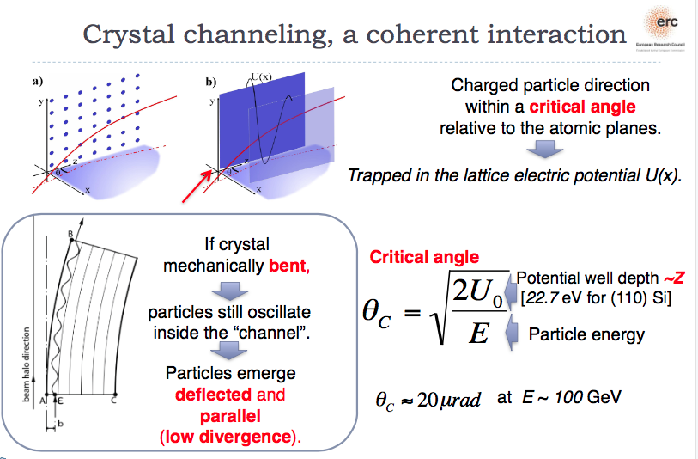
Extension of x_{F} acceptance towards x_{F} ~ 0.9 (or more?)
Gianluca Cavoto (INFN Roma)

Slide 48
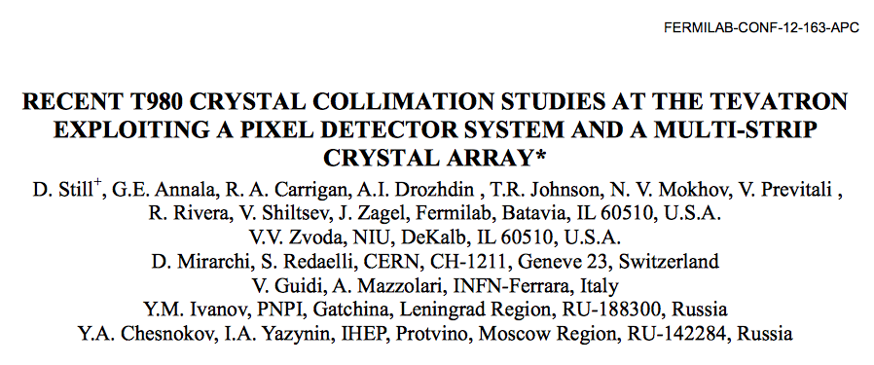
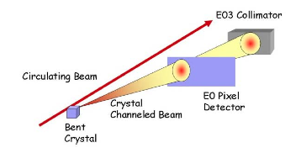
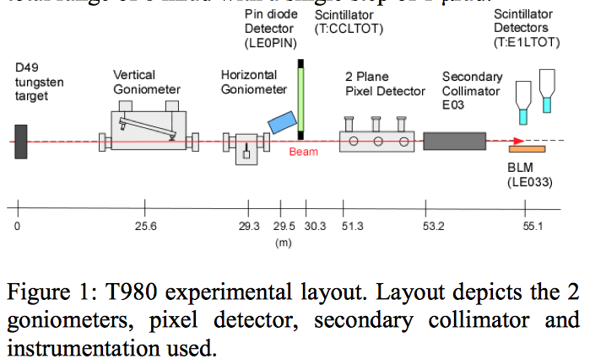
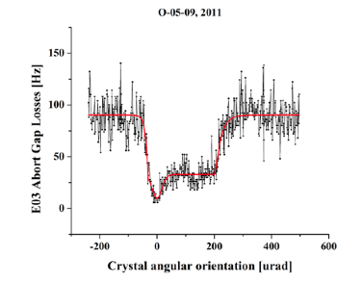
Channeling 980 GeV beam!

Slide 49
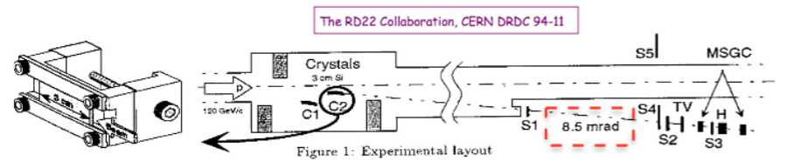

1994
Gianluca Cavoto (INFN Roma)

Slide 50


UA9 is an on-going project
studying beam halo collimation
and extraction, in SPS and in 2016
inside LHC beam pipe.
Use for SAS interesting, challenge
“Anticlastic bending” of crystal.
Photo of SPS pipe assembly
Goniometers inside LHC vacuum pipe
Move in x, y, θx, θy to cover phase space
Acceptance very small (μrad)
Deflection angles ~ 1 mrad OK, 4-5 mrad?
Several in series possible.
Positive particles only channeled.
No change in |p|, only angle.
Gianluca Cavoto (INFN Roma)

Slide 51
Fermilab involvement ??
Fermilab stretched for money and manpower with neutrinos, CMS, other …
Do not expect much … but a little can still be significant!
We have history and expertise in ~ all aspects:
Auger UHE cosmic ray showers
Event generation and track/beam line modeling (Mokhov et al., DPMJET + MARS)
Should do acceptance etc. studies also for Pts 8 and 2 (person-power)
Crystal channeling
Transition radiation detectors
Tracking (Si, pixels, 3D … ) and muon chambers
And:
Calorimetry : CMS HGCAL for upgrade ; SAS could be a perfect place for a small
“test beam” or prototype module, installed in the LHC earlier (2017?) to get
operational experience and do physics.

Slide 52
Summary
Terra Incognita : large phase space (in x_{F}, p_{T}) unexplored from √s = 63 – 13,000 GeV !
Justification in itself, but …
Need to understand Strong Interaction in non-perturbative sector
Important to understand UHE cosmic rays : Sampled shower → primary, UHE collisions, muons
Spectrometer magnets and 85m vacuum chamber + 55m straight section exist.
Need special vacuum chamber with thin exit windows. Feasible.
Technology for tracking, calorimeter, muon tracking exist, small area & can use the best!
Particle ID with transition radiation possible (π,K,p) … interesting challenge to improve.
Bent crystal channeling to extend x_{F} – coverage possible … interesting challenge to improve.
Open & accessible & small so evolution of techniques natural.
How and where?
Want many months of running with low pile-up: Pt.1 (ATLAS) and Pt.5(CMS) not good.
Pt.8 (ALICE) and Pt.2 (LHCb) have best conditions and better alignment with physics.
Both should find addition of SAS enhances their physics program, both pp and nuclei
Or : Independent new experiment (expect later merger)
In any case : TRD experts will develop suitable TR detectors
Crystal channeling experts are developing Xtals.
A milestone: Workshop in May, Italy on forward physics at LHC
It should be done and it can be done!

Slide 53
Thank You
Back Ups →

Slide 54


Broad rapidity coverage in ALICE (here Pb-Pb)
http://arxiv.org/pdf/1509.07299v1.pdf
Added value for HI collisions: measure nuclear fragments (d, t, He3, He4, …)
Better centrality measurements, forward flow, …

Slide 55
Beam pipe design (first try, very schematic)
20 cm diameter pipe from 85m to 140m (from Point 5)
Eight flared units from z = 90m to 130m
Benoit Salvant talk
25 mm thin window (Be? Al?
Minimize scattering/imteractions
θ = 5 mrad flare
VACUUM
20 cm
Inner thin foil or wire grid … maybe not needed?
5 m flared pipe unit
20 cm diam pipe
~ 40 mm
-ves
+ves
iNCOMING
BEAM
OUTGOING
BEAM

Slide 56

Agenda: Thursday morning plenary. Meeting : informal, discussions
No speaker?
(probably not)

Slide 57

Thursday afternoon parallel session

Slide 58


Parallel Session: Workshop on TRDs for SAS

Slide 59

Friday Oct 2nd Plenary
Regular meetings to develop plans. → Workshop on Forward LHC Physics, Italy in May
Stand-alone ::: ALICE extension ::: LHCb extension ?? (Effort, money, politics, … )

