Slide 1

The Role of Risk Management in Travel:
How can we help?
Risk Management
Office of Risk Management
Telephone: 225-578-3283
E-mail: riskmanagement@lsu.edu

Slide 2



Defining Property Insurance
Today’s Presenters
Cathy Krane
Assistant Vice President for Risk Management
cathykrane@lsu.edu
Ashley Neyer
Director, Office of Study Abroad
ashleyneyer@lsu.edu

Slide 3

Today’s Topics
Student Domestic Travel Insurance
  Overview
  Insurance Benefits
International Travel
  Insurance and Assistance
  High Risk Travel

Slide 4
Replacing equipment and contents
Student Domestic Travel Overview
PM 4 governs domestic student trips and student trip travel insurance and requires accident insurance coverage for:
  All University sponsored trips
  All trips in which a University faculty or staff member controls the time, route, and mode of travel
  All trips where travel costs of students are paid or reimbursed by the University
  NOTE: “University” includes the official student government organizations.

Slide 5

The following trips may be covered at the option of the student traveler and/or sponsor:
  Travel to satisfy a class requirement when the traveler determines the time, route, and mode of transportation
  Travel by individuals or groups representing the University when time, route, and mode of transportation are NOT
  controlled by University and expenses are NOT paid by
  the University
  *Charge of $0.10 per day will be charged to the traveler
  or club at the end of the semester for these trips.

Slide 6



Preferred mode of transportation for University sponsored trips:
  Public Conveyances/Carriers (buses, trains, planes, taxis, etc.)
  University owned vehicles
  Privately owned automobiles when other means of transportation are not reasonably available or as safe and dependable as the private vehicle.
Student Trip Travel Insurance does NOT cover participation in or practicing for intercollegiate activities.

Slide 7
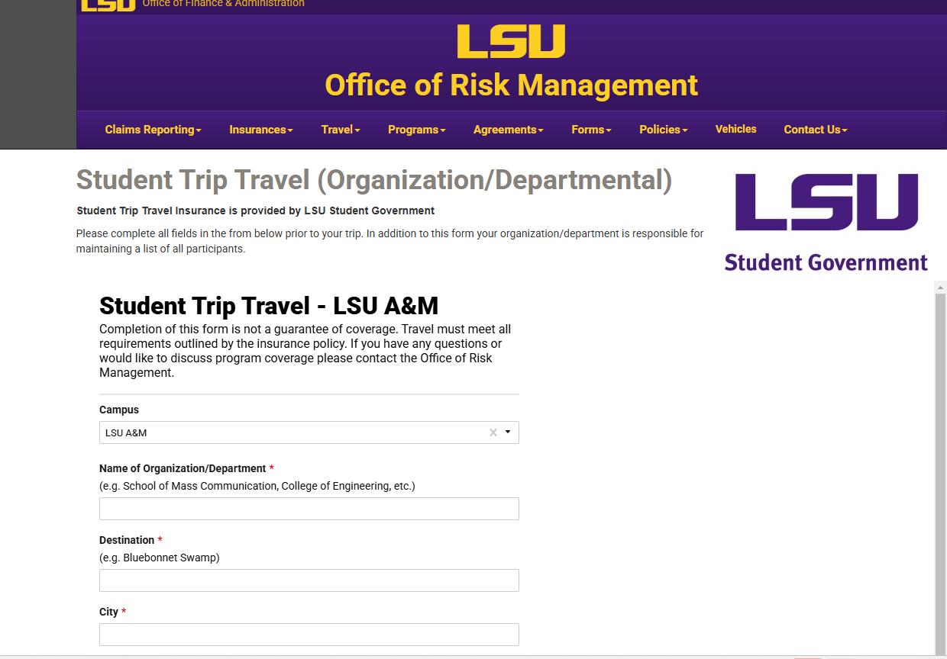
How to Enroll
Visit LSU.edu/riskmgt
Click on the Travel drop down menu
Click on the Student Travel Insurance link
Click on Requesting Coverage for your Travel / Activity
Click on the appropriate coverage request form and complete
Click Submit Form

Slide 8

Benefits
Up to $5,000 for medical expenses incurred within 52 weeks of date of accident
Up to $500 for dental expenses related to damage to natural teeth caused by accident and incurred within 52 weeks of date of accident
$7,500 for accident causing loss of life within 100 days of date of accident
$7,500 for accident causing loss with in 100 days of:
  Both hands
  OR Both feet
  OR One hand and one foot
  OR Loss of sight in both eyes
$5,000 for accident causing loss within 100 days of:
  Loss of one hand
  Loss of one foot
  Loss of sight in one eye

Slide 9

Exclusions
The Student Trip Travel insurance does not cover:
Eyeglass replacement of prescriptions
Hernia in any form
Suicide, self-destruction or any attempt thereat
Pregnancy
Pre-existing conditions
Loss covered by Worker’s Comp
Treatment by self, family members, or person employed by the policyholder
Participation in snow tubing, tobogganing, or bobsledding
Dental treatment other than injury to sound, natural teeth
Illness or accident while under the influence of alcohol, drugs or any other intoxicant

Slide 10
International Travel Insurance and Assistance Program
Louisiana State University maintains a robust program to help protect and assist our international travelers engaged in university related travel abroad.

Slide 11

Travel covered by International Travel Insurance
Employees | Students | Guest
Takes place outside of the Traveler’s Home Country. | Takes place outside of the 50 United States or the District of Columbia | Takes place outside of the Traveler’s Home Country.
Approved University Travel (Spend Authorization) | Enrolled students participating in sponsored travel or study abroad programs. | Approved University Travel (Authorization to Travel for Non-Worker - AS-516)
Includes personal deviation of no more than 14 day(s). | Including seven (7) personal days before or after the program begins or ends. | None

Slide 12

International Travel Insurance and Assistance Services
The current program through OnCall International includes benefits for medical expenses while traveling abroad, emergency evacuation and assistance, and security evacuation.
The program provides assistance in these and other emergencies as well as general advice and consultation for international travelers through On Call International.

Slide 13
Registering with OnCall
✓ If your trip was booked using LSU’s preferred travel management company, Christopherson Business Travel (CBT) or through Anthony Travel - no action is needed, your trip information was provided to On Call and you will be automatically registered
✓ If you are traveling on a trip registered through Study Abroad - no action is needed, your trip information was provided to On Call and you are registered
✓ If you fall outside the categories above, forward your trip confirmation email or itinerary and below information to trips@oncallinternational.com and tmbaisden@lsu.edu

Slide 14
Cost for Coverage
 | Current Rate Per Day of Travel
Student | $2.30
Faculty/Staff | $2.39
Guest | $2.39
Auxiliary units will be charged at the appropriate rate per day of travel for students, faculty/staff, and guests. Non auxiliary departments are not charged for faculty and staff traveling abroad on university business. Non-auxiliary departments will be charged for all guest travel and for student travel that is not registered through Study Abroad.
For all departments, charges will be assessed at the end of the fiscal year for travel during the year, and the department will be charged in July of the new fiscal year.

Slide 15
It’s more than health insurance!
Benefits
Medical
Medical Monitoring
Security
Incident Briefing
Travel
Emergency Travel Arrangements
Translator and Interpreter Referral
Emergency Travel Funds Assistance
Legal Consultation and Referral
Lost/Stolen Travel Documents Assistance
Lost Luggage Assistance
Situational Monitoring & Advice
Political Evacuation
Natural Disaster Evacuation
Medical Evacuation
Medical Repatriation
Repatriation of Remains
Emergency Travel Arrangements
Payment Guarantees
Coordination of Benefits
Telehealth Appointments
Medical, Mental Health, Dental & Pharmacy Referrals
Nurse Helpline
Prescription Assistance
Custom Pre-trip Intelligence and Risk Assessment
Incident alerts and Crisis Communication
Travel Delay Benefits

Slide 16
What’s offered for all travelers?
Coverage Overview
Deductible
$0 per Injury/Sickness
Maximum Benefit per Injury or Illness
$500,000
Bedside Visit
$12,500 Maximum
Mental Health
Up to $20,000

Slide 17
What’s excluded from the policy?
Traveling in an off-road vehicle, off-road motorcycling or automobile racing
Mountain climbing
White water rafting
Parasailing
Sky diving
Bungee jumping or spelunking
SCUBA diving
Jet, Water, or Snow Skiing
Surfing

Slide 18
In the event of an Emergency…
Inform local authorities & custom provider
Call On Call International
Study Abroad Emergency line
+1-225-578-2421
+1-603-328-6396

Slide 19
High Risk Travel

Slide 20
Travel Advisory Levels
Level 1
Exercise normal precautions
Level 2
Exercise increased caution
Level 3
Reconsider travel
Level 4
Do not travel

Slide 21
Travel Advisory Restrictions
Relative to University-related international travel, as defined in the LSU FASOP AS-18 International Travel Policy, to restricted locations and, for reasons of health, safety, security, and risk:
  The University Restricted Regions includes countries or regions of a country with a Level 3 or Level 4 Travel Advisory issued by the Department of State

Slide 22
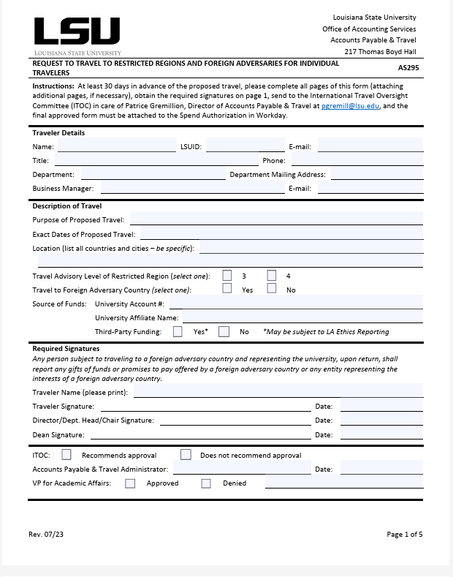
Reimbursement Process
High Risk Travel Committee
  If considering travel to a Restricted region or Foreign Adversary, Form AS295 Request to Travel must be completed and submitted to the High-Risk Travel Committee.
  The Committee will review the request and you will be notified if the travel is approved.

Slide 23
Register now for…
RISK MANAGEMENT 101
Feb. 17 or March 13
Room 301 Student Union
2:00- 4:00 pm
https://training.lsu.edu/Default.aspx?AdminGroupId=28&AudienceId=0&PageIndex=1&PageSize=10

Slide 24
Thank you for your time!
Questions???

